Slide 1
Nuclear forces with quantum computers
Matthias Degroote

Slide 2
Why does a pharmaceutical company hire quantum scientists?
Find out what is possible
01
Figure out what is real
02
Create what is missing
03

Slide 3
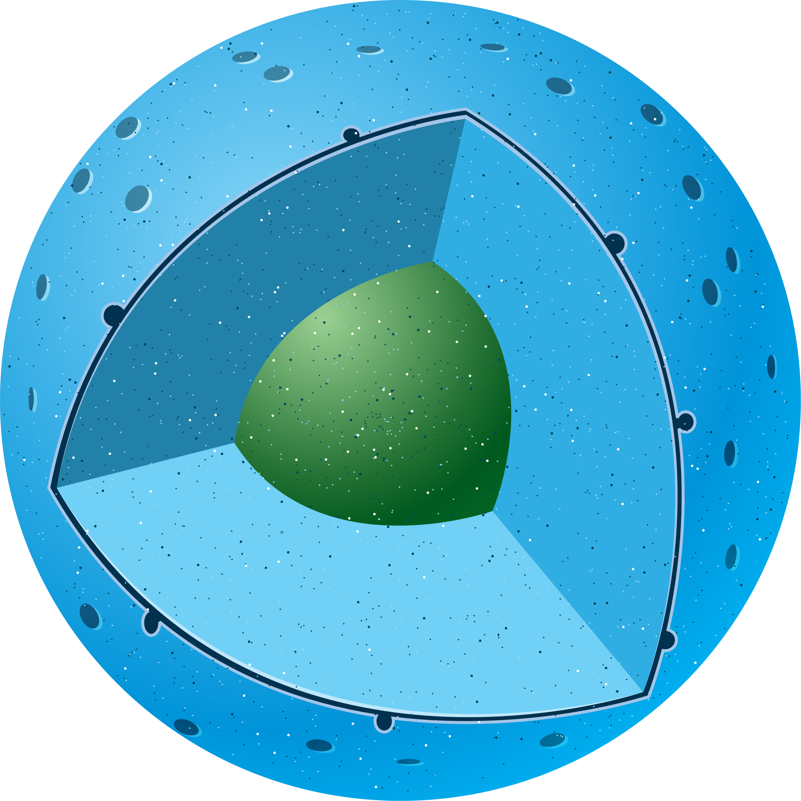
First targets: chemistry
Use cases across the pharma value chain
Research
Preclinical Development
Clinical Development
Imaging of tissues
Molecular dynamics simulation
Binding affinity prediction
ADME -properties prediction
Side-effect prediction
Potential further use cases to be identified, e.g.: trial site selection, patient selection

Slide 4
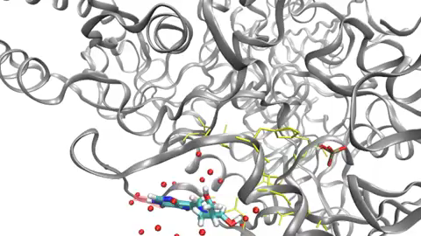
Molecular dynamics is the driver for most of our computations
Decherchi, S. et al. The ligand binding mechanism to purine nucleoside phosphorylase elucidated via molecular dynamics and machine learning. Nat. Commun. 6:6155 doi: 10.1038/ncomms7155 (2015).
Notes:
the binding mechanism of a transition state analogue (DADMe–immucillin-H) to the purine nucleoside phosphorylase (PNP) enzyme. Microsecond-long MD simulations allow us to observe several binding events, following different dynamical routes and reaching diverse binding configurations. These simulations are used to estimate kinetic and thermodynamic quantities, such as k_{on} and binding free energy, obtaining a good agreement with available experimental data. In addition, we advance a hypothesis for the slow-onset inhibition mechanism of DADMe–immucillin-H against PNP

Slide 5
Motivation: where do we need Molecular Dynamics?
Dynamical processes like chemical reactions
MD is used to propagate the atoms to the next time step in the simulation
Thermodynamic quantities like binding free energy
For an ergodic process time averages equal ensemble averages
Conformational sampling
MD is used to visit many conformations
Cluster analysis is used to select representative molecules for each cluster
Find energy minima through simulated annealing
Increase temperature to access all configurations
Slowly lower the temperature to only keep the minimum
De Vivo, M. et al. Role of Molecular Dynamics and Related Methods in Drug Discovery. Journal of Medicinal Chemistry 2016 59 (9), 4035-4061 doi: 10.1021/acs.jmedchem.5b01684

Slide 6
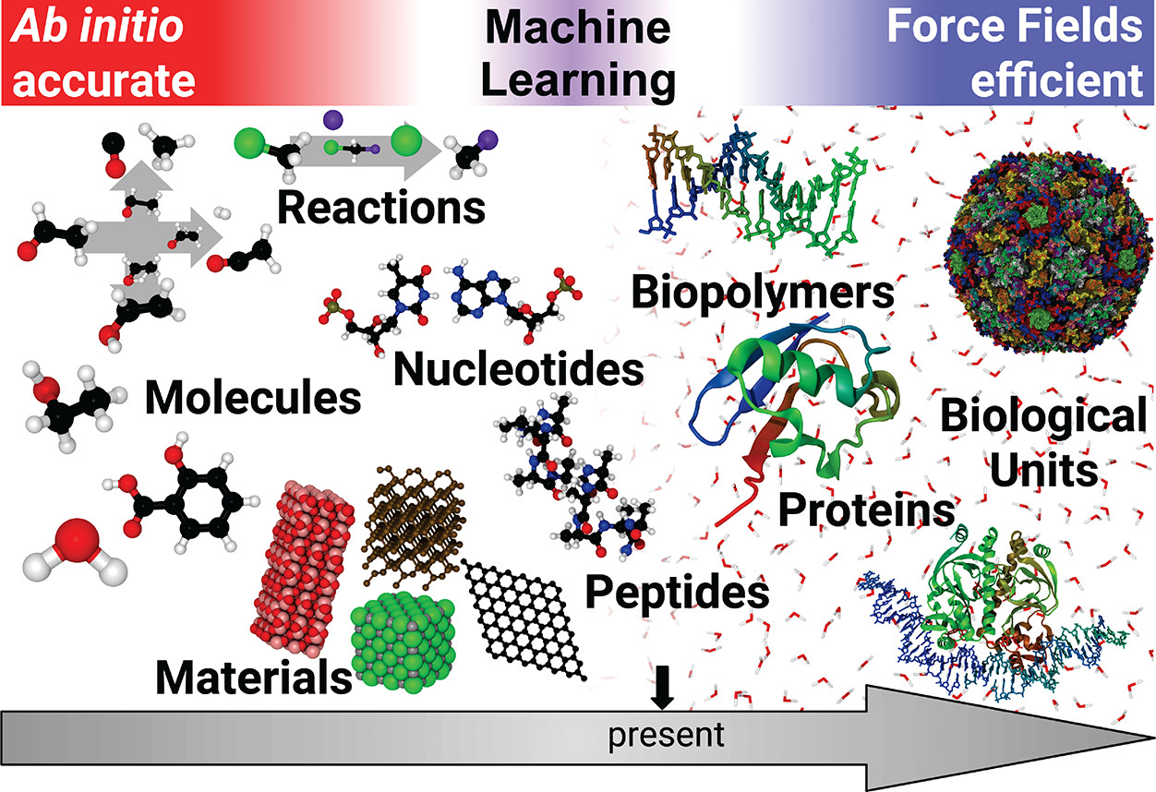
Recap: How is this connected to what we have seen so far?
Treatment of the nuclei
Quantum mechanical
Classical
Coupling between nuclear and electronic degrees of freedom
Full quantum solution
Quantum-classical
Born-Oppenheimer
Potential energy surface
Empirical
Machine Learning
Ab initio
Unke, O.T. et al. Machine Learning Force Fields. Chem. Rev. 2021 121 16 doi:10.1021/acs.chemrev.0c01111
Limitations
Only slow, near-equilibrium dynamics
No excited states
Very expensive, so very small systems

Slide 7
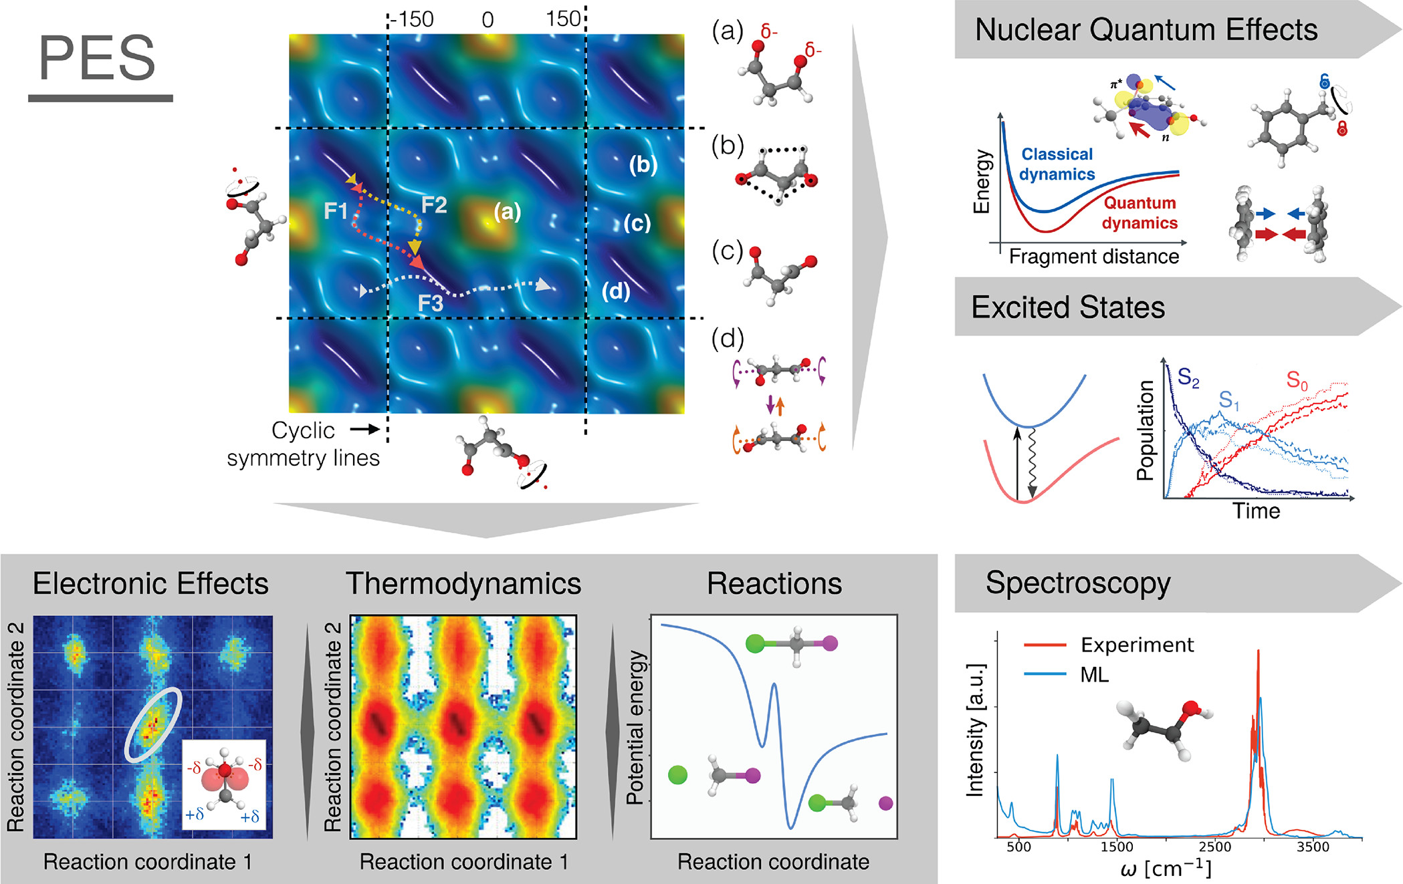
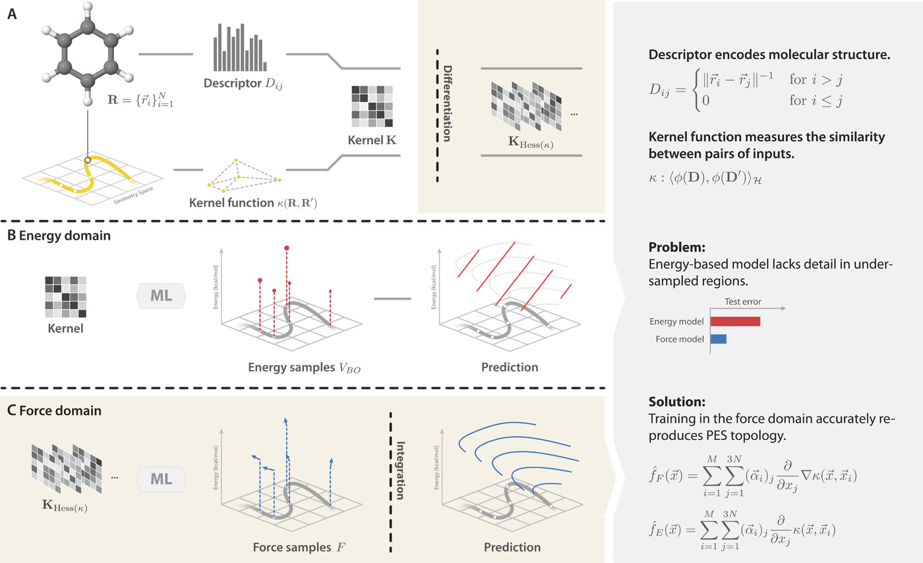
Recap: How is this connected to what we have seen so far?
Synergies
Learning on accurate PES
Learning on accurate forces
Unke, O.T. et al. Machine Learning Force Fields. Chem. Rev. 2021 121 16 doi:10.1021/acs.chemrev.0c01111
Chmiela, S. et al. Machine learning of accurate energy-conserving molecular force fields. Sci. Adv. 2017 3 (5) doi:10.1126/sciadv.1603015

Slide 8
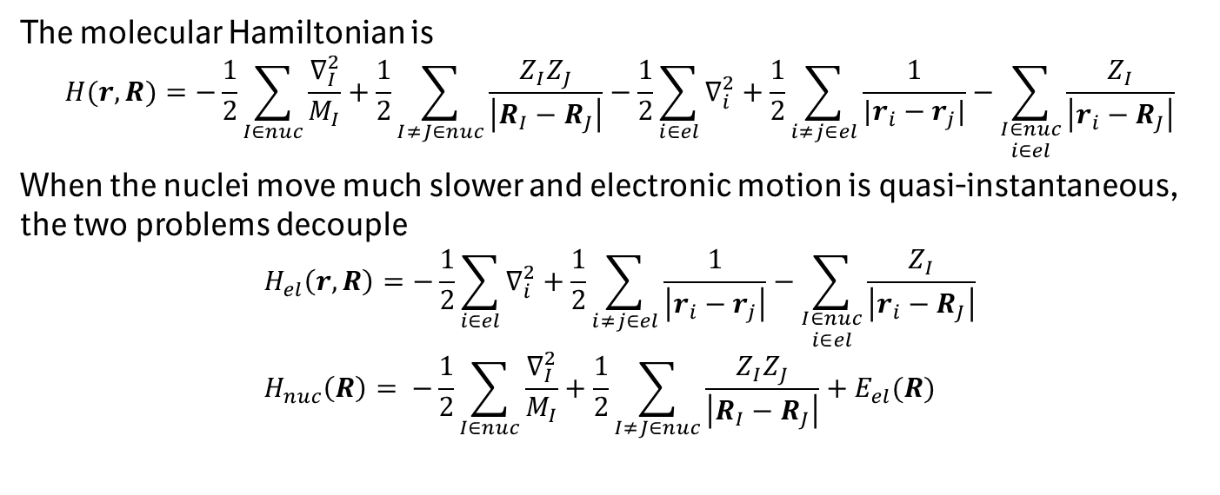
Born-Oppenheimer approximation
The molecular Hamiltonian is
$$H(r, R)=−\frac{1}{2}\sum_{I∈nuc}{\frac{∇_{I}^{2}}{M_{I}}}+\frac{1}{2}\sum_{I≠J∈nuc}{\frac{Z_{I}Z_{J}}{\left|R_{I}−R_{J}\right|}−\frac{1}{2}\sum_{i∈el}{∇_{i}^{2}}+\frac{1}{2}\sum_{i≠j∈el}{\frac{1}{|r_{i}−r_{j}|}−\sum_{\begin{aligned}I∈nuc \\ i∈el\end{aligned}}{\frac{Z_{I}}{\left|r_{i}−R_{J}\right|}}}}$$
When the nuclei move much slower and electronic motion is quasi-instantaneous, the two problems decouple
$$H_{el}\left(r,R\right)=−\frac{1}{2}\sum_{i∈el}{∇_{i}^{2}}+\frac{1}{2}\sum_{i≠j∈el}{\frac{1}{\left|r_{i}−r_{j}\right|}−\sum_{\begin{aligned}I∈nuc \\ i∈el\end{aligned}}{\frac{Z_{I}}{\left|r_{i}−R_{J}\right|}}} \\ H_{nuc}\left(R\right)= −\frac{1}{2}\sum_{I∈nuc}{\frac{∇_{I}^{2}}{M_{I}}}+\frac{1}{2}\sum_{I≠J∈nuc}{\frac{Z_{I}Z_{J}}{\left|R_{I}−R_{J}\right|}+E_{el}(R)}$$

Slide 9
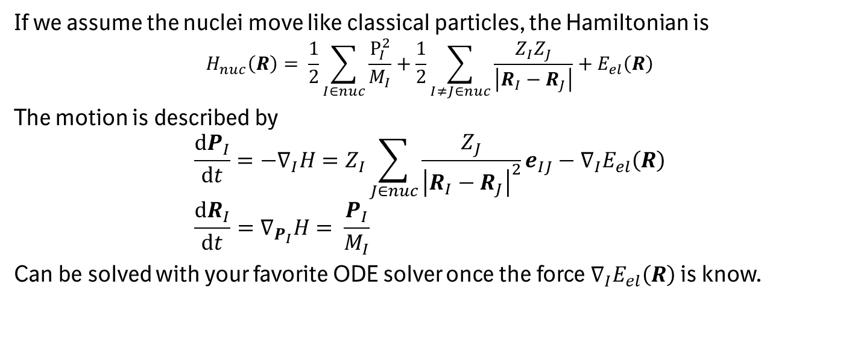
Born-Oppenheimer
If we assume the nuclei move like classical particles, the Hamiltonian is
$$H_{nuc}\left(R\right)= \frac{1}{2}\sum_{I∈nuc}{\frac{P_{I}^{2}}{M_{I}}}+\frac{1}{2}\sum_{I≠J∈nuc}{\frac{Z_{I}Z_{J}}{\left|R_{I}−R_{J}\right|}+E_{el}\left(R\right)}$$
The motion is described by
$$\frac{dP_{I}}{dt}=−∇_{I}H=Z_{I}\sum_{J∈nuc}{\frac{Z_{J}}{{\left|R_{I}−R_{J}\right|}^{2}}}e_{IJ}−∇_{I}E_{el}\left(R\right) \\ \frac{dR_{I}}{dt}=∇_{P_{I}}H= \frac{P_{I}}{M_{I}}$$
Can be solved with your favorite ODE solver once the force $∇_{I}E_{el}\left(R\right)$ is know.

Slide 10
Forces in NISQ

Slide 11
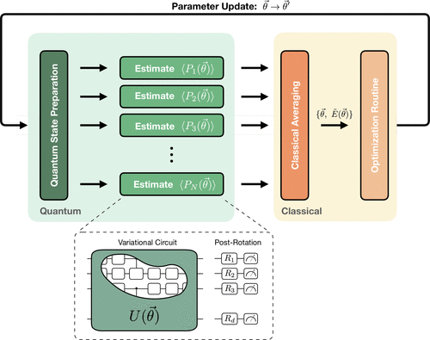
Energy calculation in NISQ with VQE
Cao, Y et al. Quantum chemistry in the age of quantum computing. Chem. Rev. (2019) 119 19 doi:10.1021/acs.chemrev.8b00803

Slide 12
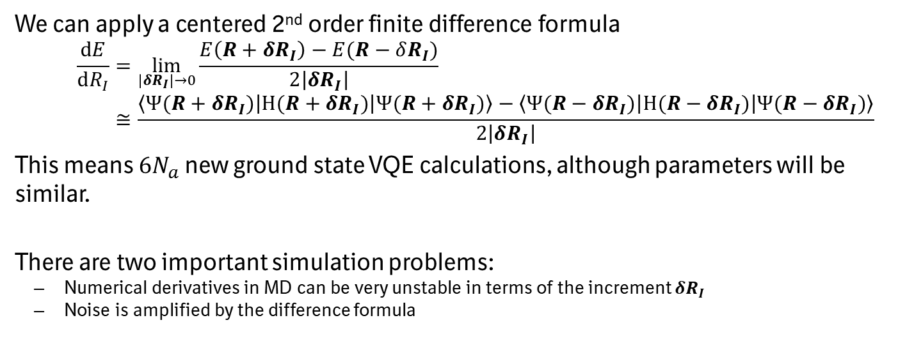
Numerical derivative through finite differences on the energy
We can apply a centered 2nd order finite difference formula
$$\frac{dE}{dR_{I}}=\lim_{|δR_{I}|→0}{\frac{E\left(R+δR_{I}\right)−E(R−δR_{I})}{2\left|δR_{I}\right|}} \\ ≅\frac{\left\langle Ψ(R+δR_{I}) | H(R+δR_{I}) | Ψ(R+δR_{I})\right\rangle −\left\langle Ψ(R−δR_{I}) | H(R−δR_{I}) | Ψ(R−δR_{I})\right\rangle }{2\left|δR_{I}\right|}$$
This means $6N_{a}$ new ground state VQE calculations, although parameters will be similar.
There are two important simulation problems:
Numerical derivatives in MD can be very unstable in terms of the increment $δR_{I}$
Noise is amplified by the difference formula

Slide 13
Stability issues of numerical derivatives
Fedorov, D.A. et al. Ab initio molecular dynamics on quantum computers J. Chem. Phys (2021) 154, 164103 doi:10.1063/5.0046930

Slide 14
Numerical differentiation in a noisy setting
Not very scalable…
Fedorov, D.A. et al. Ab initio molecular dynamics on quantum computers J. Chem. Phys (2021) 154, 164103 doi:10.1063/5.0046930

Slide 15
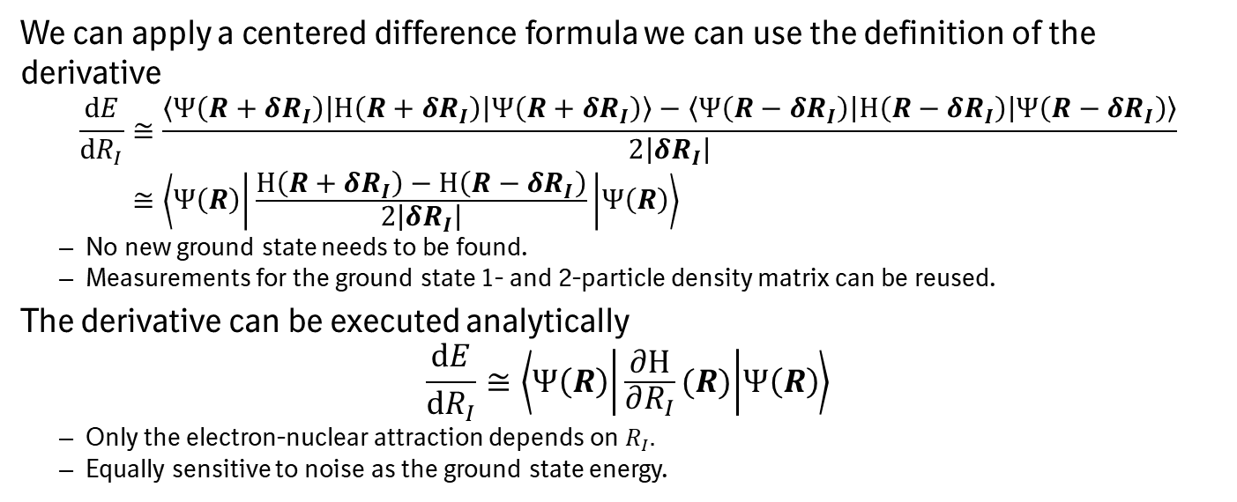
Hellman-Feynman or finite differences on the Hamiltonian
We can apply a centered difference formula we can use the definition of the derivative
$$\frac{dE}{dR_{I}}≅\frac{\left\langle Ψ\left(R+δR_{I}\right) | H\left(R+δR_{I}\right) | Ψ\left(R+δR_{I}\right)\right\rangle −\left\langle Ψ\left(R−δR_{I}\right) | H\left(R−δR_{I}\right) | Ψ\left(R−δR_{I}\right)\right\rangle }{2\left|δR_{I}\right|} \\ ≅\left\langle Ψ\left(R\right) | \frac{H\left(R+δR_{I}\right)−H\left(R−δR_{I}\right)}{2\left|δR_{I}\right|} | Ψ\left(R\right)\right\rangle$$
No new ground state needs to be found.
Measurements for the ground state 1- and 2-particle density matrix can be reused.
The derivative can be executed analytically
$$\frac{dE}{dR_{I}}≅\left\langle Ψ\left(R\right) | \frac{∂H}{∂R_{I}}(R) | Ψ\left(R\right)\right\rangle$$
Only the electron-nuclear attraction depends on $R_{I}.$
Equally sensitive to noise as the ground state energy.

Slide 16
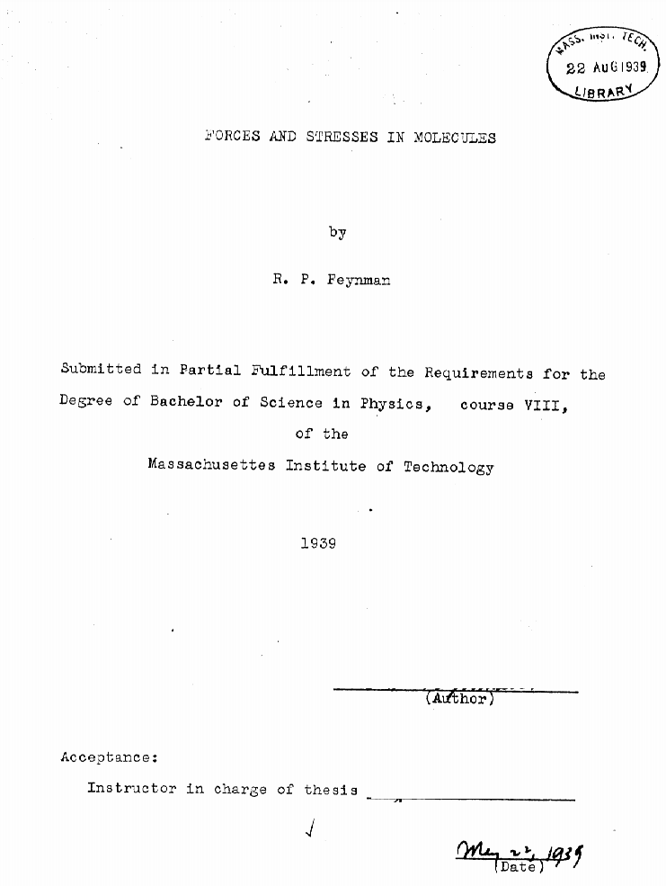
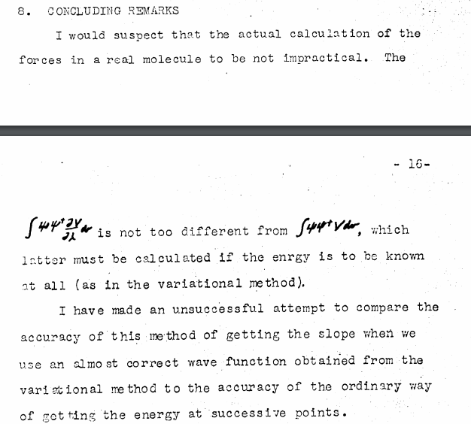
This was Richard Feynman’s Bachelor’s thesis subject
Just try things! You never know…
Feynman, R.P. Forces in Molecules Phys. Rev. (1939) 56 340-343 doi:10.1103/PhysRev.56.340

Slide 17
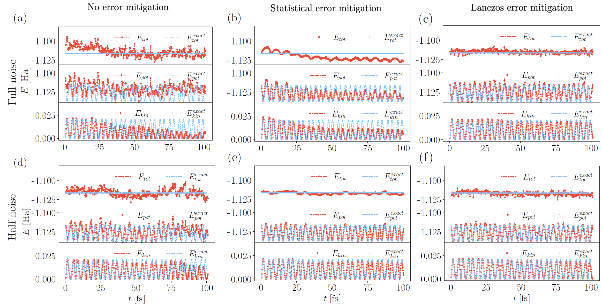
Noisy simulation of MD with Hellman-Feynman forces
Sokolov, I.O. et al. Microcanonical and finite-temerpature ab initio molecular dynamics simulations on quantum computers. Phys. Rev. Research (2021) 3, 013125 doi:10.1103/PhysRevResearch.3.013125
Notes:
Time series of the total, potential, and kinetic energies for the dynamics of the H2 molecule (t = 100 fs, dt = 0.2 fs) using the
VQE algorithm with the realistic noise corresponding to the ibmq_athens device and: (a) 8192 measurements for the evaluation of energies and
forces, (b) 81 920 measurements for the evaluation of energies and forces, and (c) the VQE-L error mitigation scheme with 8192 measurements
for the evaluation of energies and forces. (d), (e), and (f) The same simulations as in (a), (b), and (c) with halved hardware noise level. In all
panels, the blue curves correspond to the reference “exact” dynamics obtained in the MR.

Slide 18
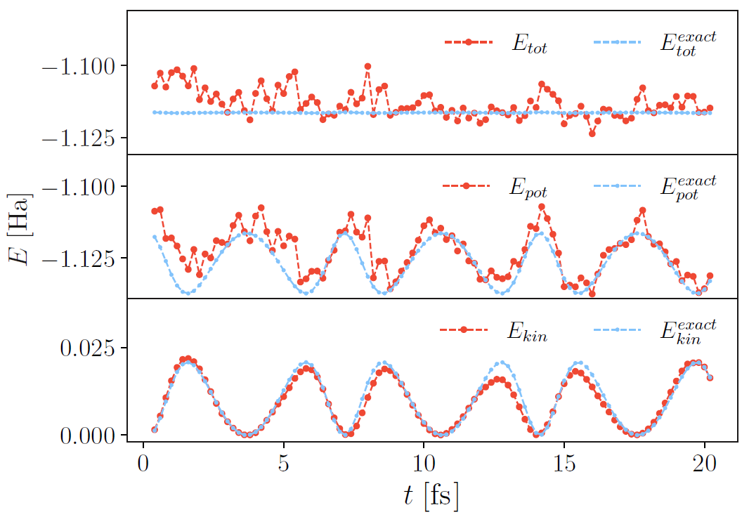
Hardware experiment of MD with Hellman-Feynman forces
But what with the piece we neglected?
Sokolov, I.O. et al. Microcanonical and finite-temperature ab initio molecular dynamics simulations on quantum computers. Phys. Rev. Research (2021) 3, 013125 doi:10.1103/PhysRevResearch.3.013125
Notes:
FIG. 6. Time series of the total, potential, and kinetic energies
for the dynamics of the H2 molecule on the IBM quantum computer
ibmq_athens. Calculations were done using the bare VQE algorithm
(without Lanczos noise mitigation) with 8192 measurements
per expectation value. The equation of motion was solved with the
velocity-free Verlet algorithm and a time step of 0.2 fs.

Slide 19
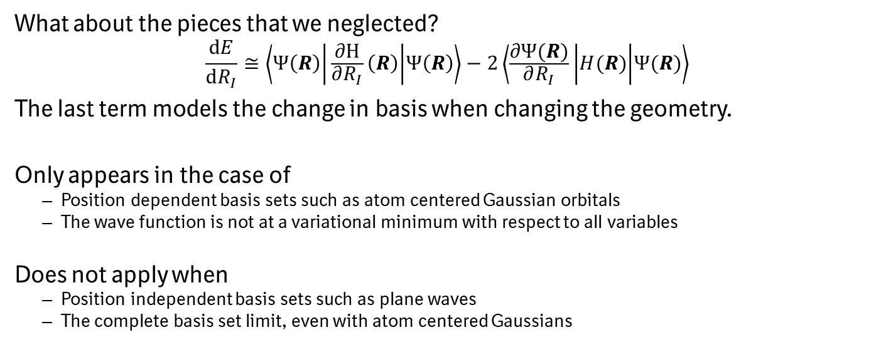
Pulay terms
What about the pieces that we neglected?
$$\frac{dE}{dR_{I}}≅\left\langle Ψ\left(R\right) | \frac{∂H}{∂R_{I}}\left(R\right) | Ψ\left(R\right)\right\rangle −2\left\langle \frac{∂Ψ(R)}{∂R_{I}} | H(R) | Ψ(R)\right\rangle$$
The last term models the change in basis when changing the geometry.
Only appears in the case of
Position dependent basis sets such as atom centered Gaussian orbitals
The wave function is not at a variational minimum with respect to all variables
Does not apply when
Position independent basis sets such as plane waves
The complete basis set limit, even with atom centered Gaussians
Pulay, P. Ab initio calculation of force constants and equilibrium geometries in polyatomic molecules. Mol. Phys (1970) 17:2, 197-204. doi:10.1080/00268976900100941

Slide 20
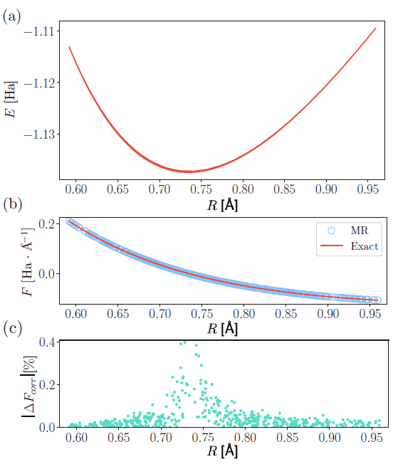
How important are the Pulay terms?
As always, system dependent…
Sokolov, I.O. et al. Microcanonical and finite-temperature ab initio molecular dynamics simulations on quantum computers. Phys. Rev. Research (2021) 3, 013125 doi:10.1103/PhysRevResearch.3.013125
Pulay, P. Ab initio calculation of force constants and equilibrium geometries in polyatomic molecules. Mol. Phys (1970) 18:4, 473-480. doi:10.1080/00268977000100541

Slide 21
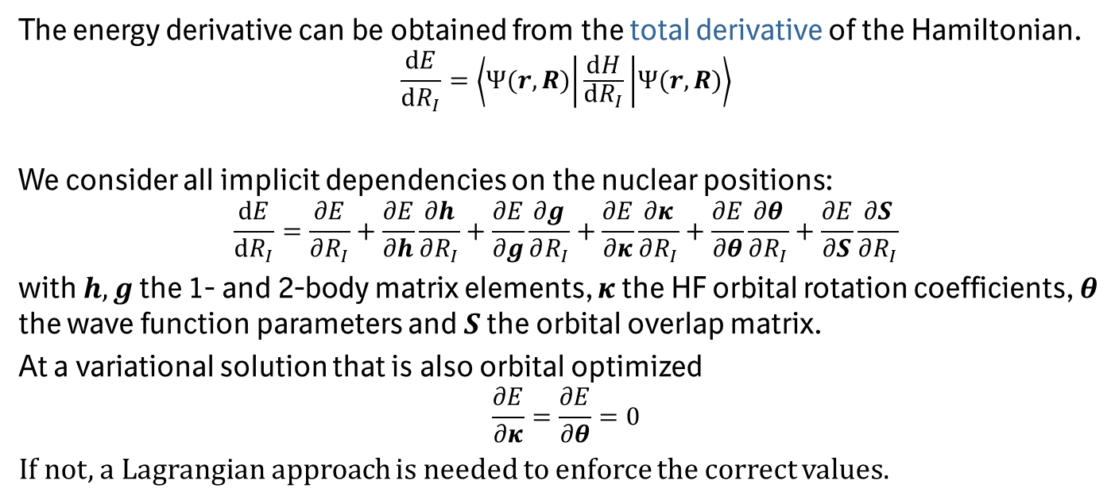
Analytical derivatives
The energy derivative can be obtained from the total derivative of the Hamiltonian.
$$\frac{dE}{dR_{I}}=\left\langle Ψ(r,R) | \frac{dH}{dR_{I}} | Ψ(r,R)\right\rangle$$
We consider all implicit dependencies on the nuclear positions:
$$\frac{dE}{dR_{I}}=\frac{∂E}{∂R_{I}}+\frac{∂E}{∂h}\frac{∂h}{∂R_{I}}+\frac{∂E}{∂g}\frac{∂g}{∂R_{I}}+\frac{∂E}{∂κ}\frac{∂κ}{∂R_{I}}+\frac{∂E}{∂θ}\frac{∂θ}{∂R_{I}}+\frac{∂E}{∂S}\frac{∂S}{∂R_{I}}$$
with $h, g$ the 1- and 2-body matrix elements, $κ$ the HF orbital rotation coefficients, $θ$ the wave function parameters and $S$ the orbital overlap matrix.
At a variational solution that is also orbital optimized
$$\frac{∂E}{∂κ}=\frac{∂E}{∂θ}=0$$
If not, a Lagrangian approach is needed to enforce the correct values.

Slide 22
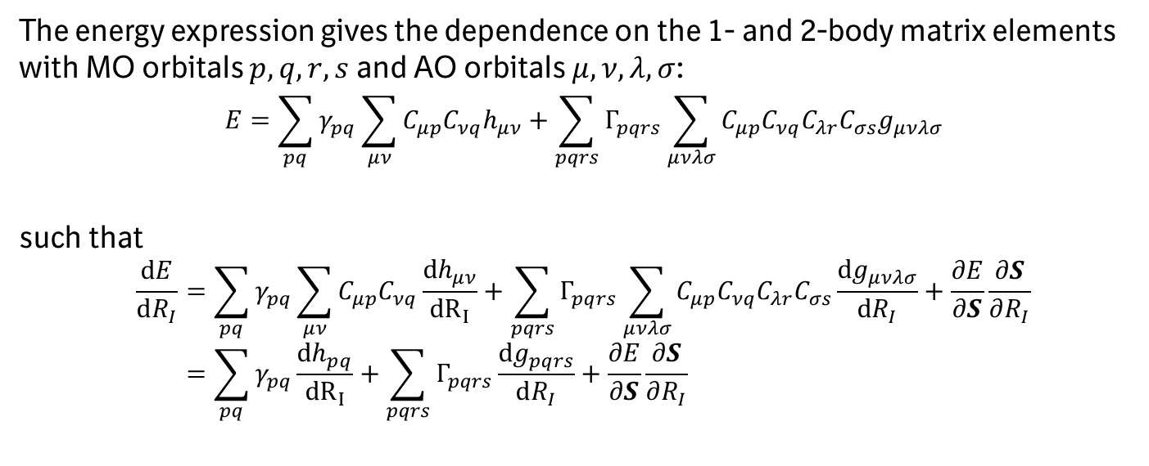
Derivatives with respect to matrix elements
The energy expression gives the dependence on the 1- and 2-body matrix elements with MO orbitals $p,q,r,s$ and AO orbitals $μ,ν,λ,σ$:
$$E=\sum_{pq}{γ_{pq}\sum_{μν}{C_{μp}C_{νq}h_{μν}}}+\sum_{pqrs}{Γ_{pqrs}\sum_{μνλσ}{C_{μp}C_{νq}C_{λr}C_{σs}g_{μνλσ}}}$$
such that
$$\frac{dE}{dR_{I}}=\sum_{pq}{γ_{pq}\sum_{μν}{C_{μp}C_{νq}\frac{{dh}_{μν}}{{dR}_{I}}}}+\sum_{pqrs}{Γ_{pqrs}\sum_{μνλσ}{C_{μp}C_{νq}C_{λr}C_{σs}\frac{dg_{μνλσ}}{dR_{I}}}}+\frac{∂E}{∂S}\frac{∂S}{∂R_{I}} \\ =\sum_{pq}{γ_{pq}\frac{{dh}_{pq}}{{dR}_{I}}}+\sum_{pqrs}{Γ_{pqrs}\frac{dg_{pqrs}}{dR_{I}}}+\frac{∂E}{∂S}\frac{∂S}{∂R_{I}}$$

Slide 23
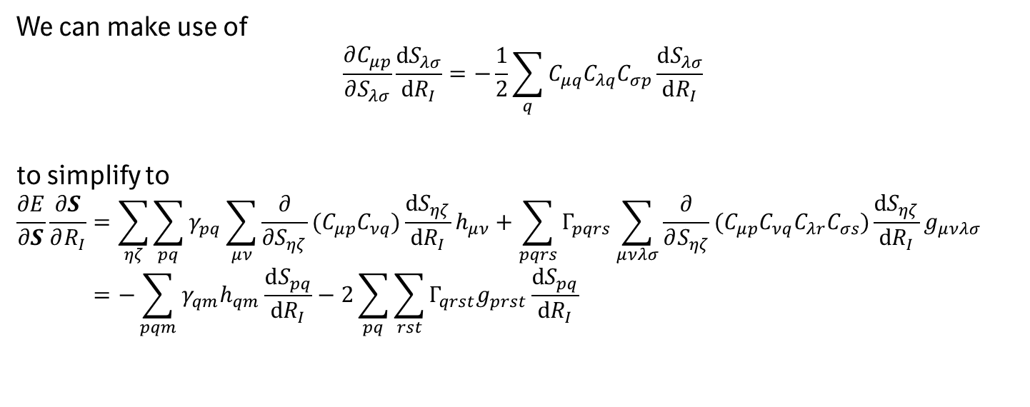
Derivatives with respect to the overlap matrix
We can make use of
$$\frac{∂C_{μp}}{∂S_{λσ}}\frac{dS_{λσ}}{dR_{I}}=−\frac{1}{2}\sum_{q}{C_{μq}C_{λq}C_{σp}\frac{dS_{λσ}}{dR_{I}}}$$
to simplify to
$$\frac{∂E}{∂S}\frac{∂S}{∂R_{I}}=\sum_{ηζ}{\sum_{pq}{γ_{pq}\sum_{μν}{\frac{∂}{{∂S}_{ηζ}}(C_{μp}C_{νq})\frac{dS_{ηζ}}{dR_{I}}h_{μν}}}}+\sum_{pqrs}{Γ_{pqrs}\sum_{μνλσ}{{\frac{∂}{∂S_{ηζ}}(C_{μp}C_{νq}C_{λr}C_{σs})\frac{dS_{ηζ}}{dR_{I}}g}_{μνλσ}}} \\ =−\sum_{pqm}{γ_{qm}h_{qm}\frac{dS_{pq}}{dR_{I}}}−2\sum_{pq}{\sum_{rst}{Γ_{qrst}g_{prst}\frac{dS_{pq}}{dR_{I}}}}$$
See appendix A in Arxiv:2111.12437

Slide 24
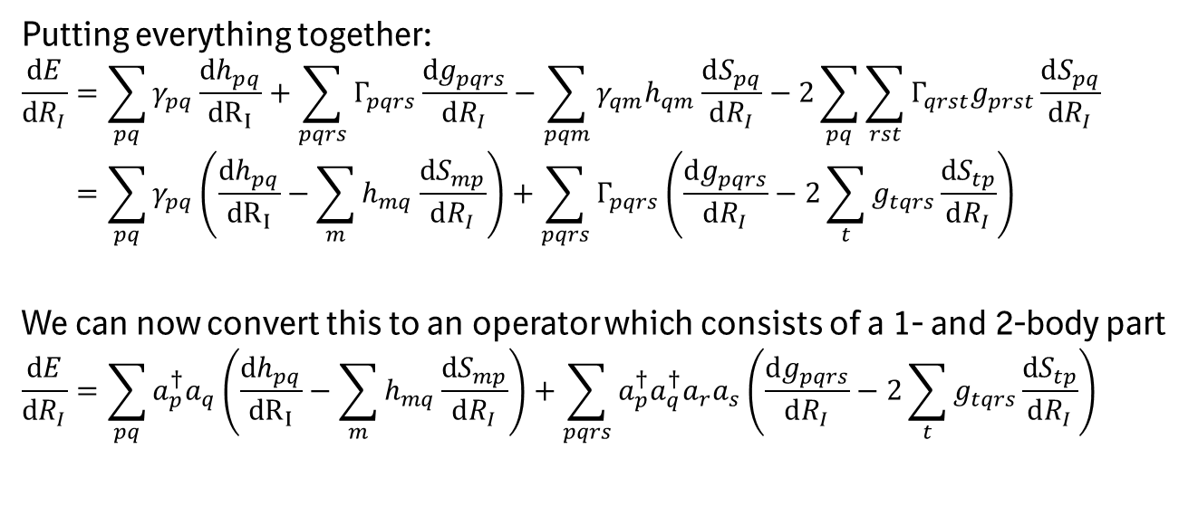
From expectation value to operator
Putting everything together:
$$\frac{dE}{dR_{I}}=\sum_{pq}{γ_{pq}\frac{{dh}_{pq}}{{dR}_{I}}}+\sum_{pqrs}{Γ_{pqrs}\frac{dg_{pqrs}}{dR_{I}}}−\sum_{pqm}{γ_{qm}h_{qm}\frac{dS_{pq}}{dR_{I}}}−2\sum_{pq}{\sum_{rst}{Γ_{qrst}g_{prst}\frac{dS_{pq}}{dR_{I}}}} \\ =\sum_{pq}{γ_{pq}\left(\frac{{dh}_{pq}}{{dR}_{I}}−\sum_{m}{h_{mq}\frac{dS_{mp}}{dR_{I}}}\right)}+\sum_{pqrs}{Γ_{pqrs}\left(\frac{dg_{pqrs}}{dR_{I}}−2\sum_{t}{g_{tqrs}\frac{dS_{tp}}{dR_{I}}}\right)}$$
We can now convert this to an operator which consists of a 1- and 2-body part
$$\frac{dE}{dR_{I}}=\sum_{pq}{a_{p}^{†}a_{q}\left(\frac{{dh}_{pq}}{{dR}_{I}}−\sum_{m}{h_{mq}\frac{dS_{mp}}{dR_{I}}}\right)}+\sum_{pqrs}{a_{p}^{†}a_{q}^{†}a_{r}a_{s}\left(\frac{dg_{pqrs}}{dR_{I}}−2\sum_{t}{g_{tqrs}\frac{dS_{tp}}{dR_{I}}}\right)}$$

Slide 25
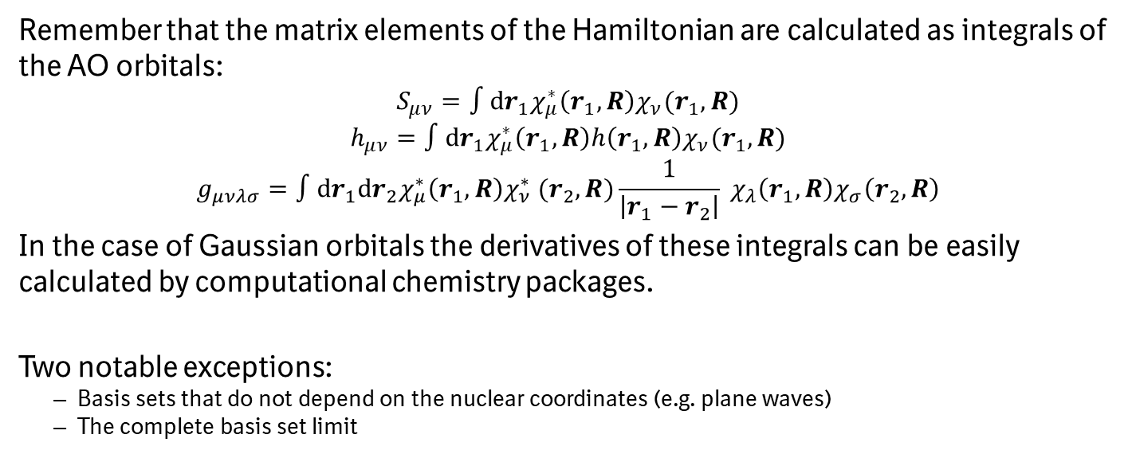
Where do we get the remaining derivatives?
Remember that the matrix elements of the Hamiltonian are calculated as integrals of the AO orbitals:
$$S_{μν}=∫dr_{1}χ_{μ}^{∗}\left(r_{1},R\right)χ_{ν}(r_{1},R)$$
$$h_{μν}=∫dr_{1}χ_{μ}^{∗}\left(r_{1},R\right)h\left(r_{1},R\right)χ_{ν}(r_{1},R)$$
$$g_{μνλσ}=∫dr_{1}dr_{2}χ_{μ}^{∗}\left(r_{1},R\right)χ_{ν}^{∗} (r_{2},R)\frac{1}{\left|r_{1}−r_{2}\right|} χ_{λ}\left(r_{1},R\right)χ_{σ}\left(r_{2},R\right)$$
In the case of Gaussian orbitals the derivatives of these integrals can be easily calculated by computational chemistry packages.
Two notable exceptions:
Basis sets that do not depend on the nuclear coordinates (e.g. plane waves)
The complete basis set limit

Slide 26
How do we measure these operators?
Finding basis rotations that diagonalize as many operators as possible
Clifford group for commuting or qubit commuting subsets
Givens rotations or double factorization (DF)
But not all derivatives in the vector are diagonalized by the same set of rotations and you only get the expectation value of the subset.
Build a model for the state with fermionic shadow tomography by random measurements
Assign different weights to different operators through importance sampling with parallel measurements for multiple force operators

Slide 27
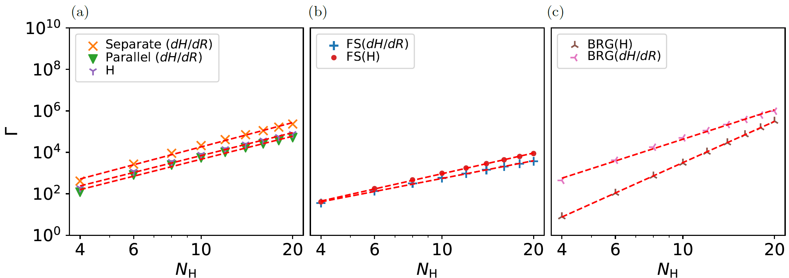
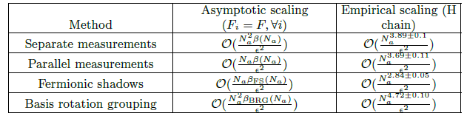
Scaling of force operator calculations
Not as cheap as we had expected…
O’Brien, T.E. et al. Efficient quantum computation of molecular forces and other energy gradients. arXiv:2111.12437 (2021)

Slide 28
Conclusions
There are several methods that allow us to calculate nuclear derivatives of energies. They are standing on the shoulders of many years of electronic structure developments.
There seems to be no quality of the quantum computer that would make classical MD driven by VQE faster than classical computers.
If we replace the classical electronic structure driver with VQE, the quantum computer needs to outperform all classical computers at the same task. This is unlikely in NISQ.

Slide 29
Forces in FTQC

Slide 30
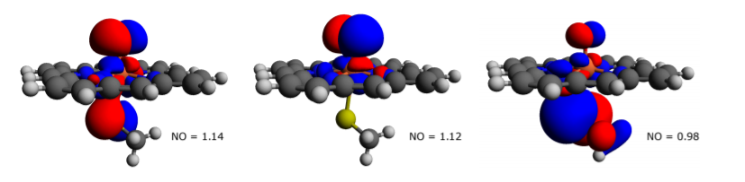
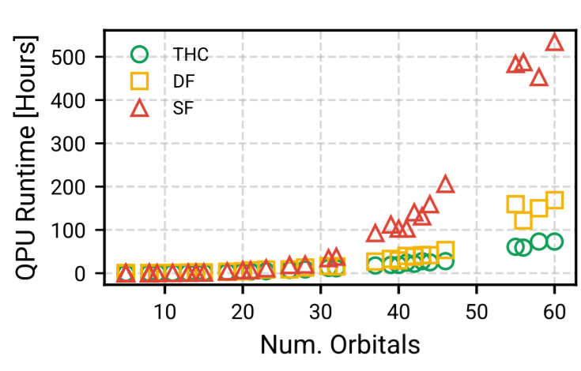
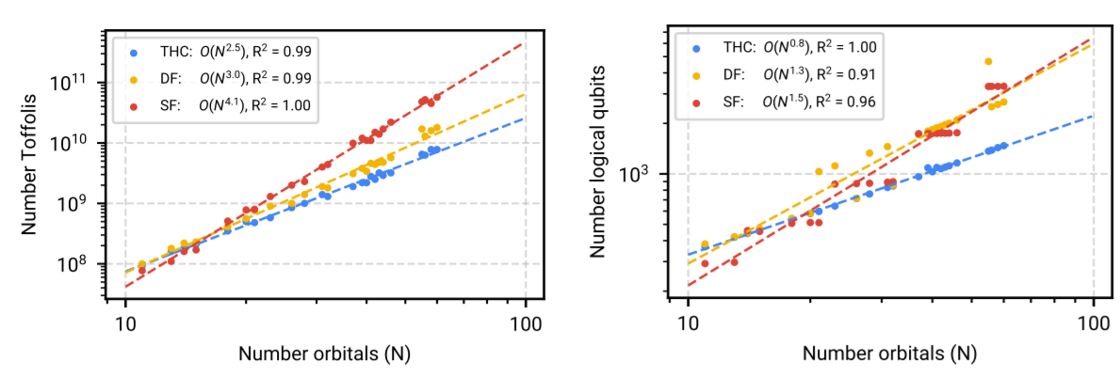
FTQC energy calculation
Everything now depends on the error correction code distance needed to sufficiently suppress the noise exponentially
Goings, J.J. et al. Reliably assessingthe electronic structure of cytochrome P450 on today’s classical computers and tomorrow’s quantum computers. arXiv:2202.01244

Slide 31
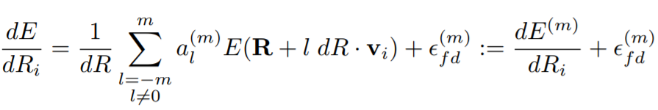
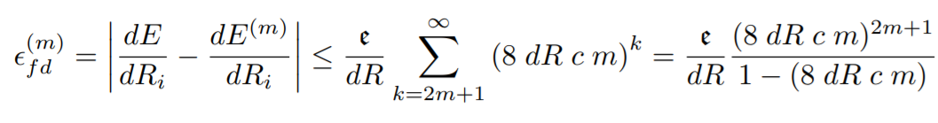
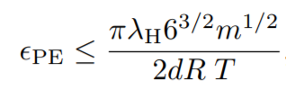
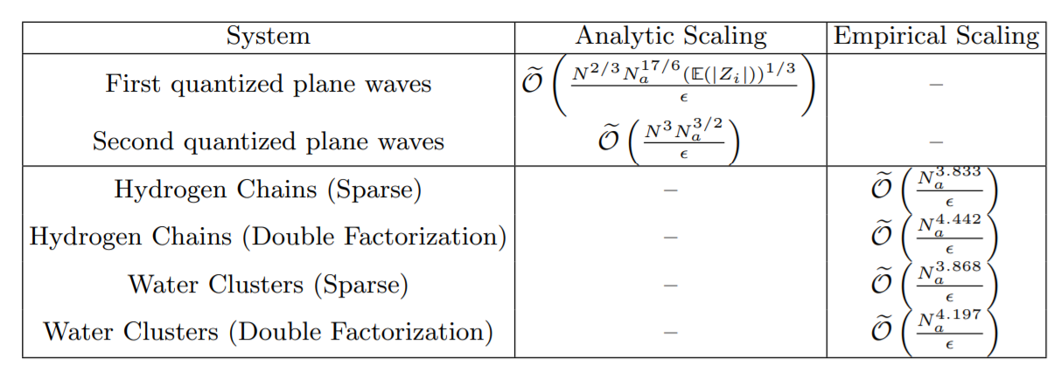
Higher order finite differences
O’Brien, T.E. et al. Efficient quantum computation of molecular forces and other energy gradients. arXiv:2111.12437 (2021)

Slide 32
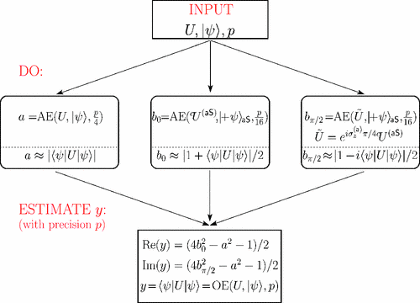
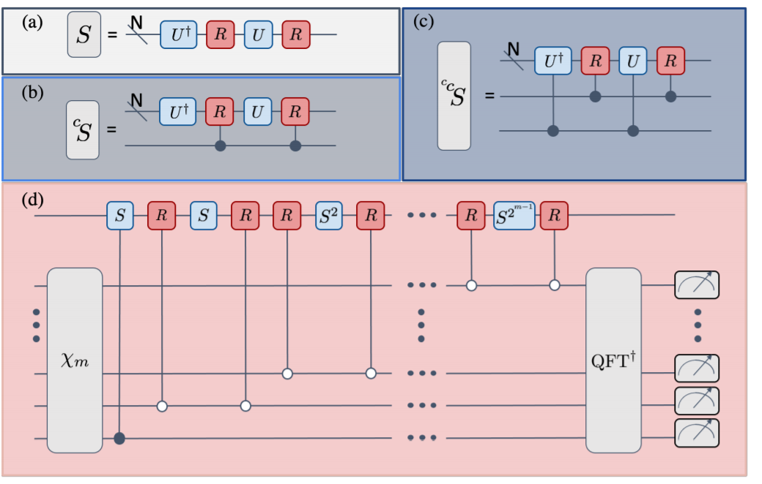
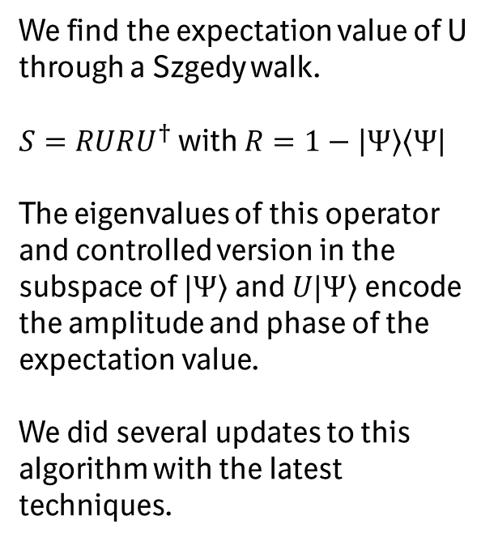
Knill expectation value estimation algorithm
We find the expectation value of U through a Szgedy walk.
$S=RURU^{†}$ with $R=1−\left|\left.Ψ\right\rangle \left\langle Ψ\right.\right|$
The eigenvalues of this operator and controlled version in the subspace of $\left.|Ψ\right\rangle$ and $\left.U|Ψ\right\rangle$ encode the amplitude and phase of the expectation value.
We did several updates to this algorithm with the latest techniques.
Knill, E. et al. Optimal quantum measurements of expectation values of observables. Phys. Rev. A (2007) 75 012328 doi:10.1103/PhysRevA.75.012328
O’Brien, T.E. et al. Efficient quantum computation of molecular forces and other energy gradients. arXiv:2111.12437 (2021)

Slide 33
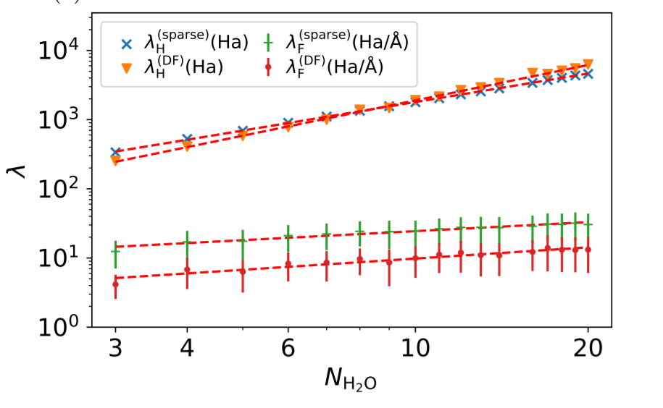
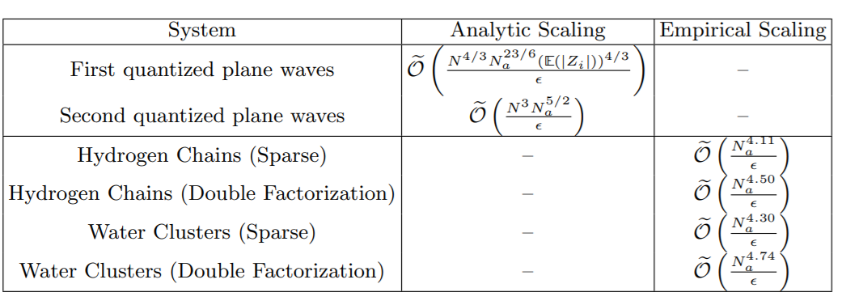
Importance of the 1-norms
O’Brien, T.E. et al. Efficient quantum computation of molecular forces and other energy gradients. arXiv:2111.12437 (2021)

Slide 34
Conclusions
It is very hard to beat QPE.
There are many improvements to make but it is hard if you can not test anything to get real runtimes.
There needs to be considerable algorithm development to make these perfect machines do useful things.
We are really not that interested in the forces.

Slide 35
Thank you for your attention
Feel free to reach out:
matthias.degroote@boehringer-ingelheim.com

